Slide 1
Introduction to uniparental markers (mtDNA and Y-Chromosome)
Albert Min-Shan Ko
July 13, 2018
IVPP, Beijing

Slide 2
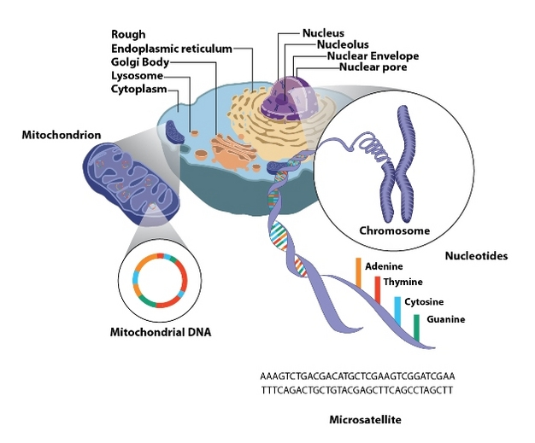
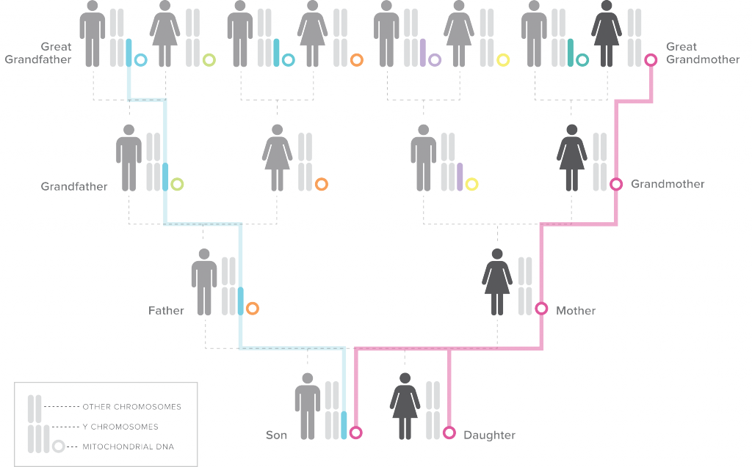
Part 1. mtDNA function with some reference to positive selection
Part 2. mtDNA existing as heteroplasmy
Part 3. Concept of a haplogroup that is used in population genetics
https://genographic.nationalgeographic.com/v/

Slide 3
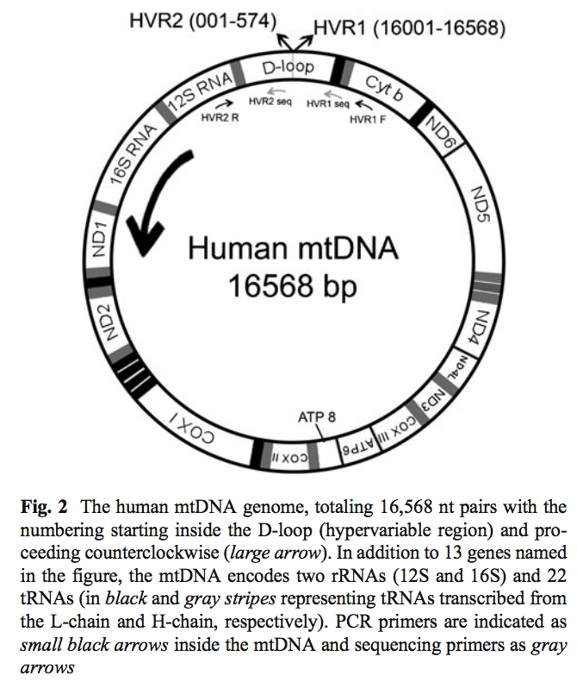
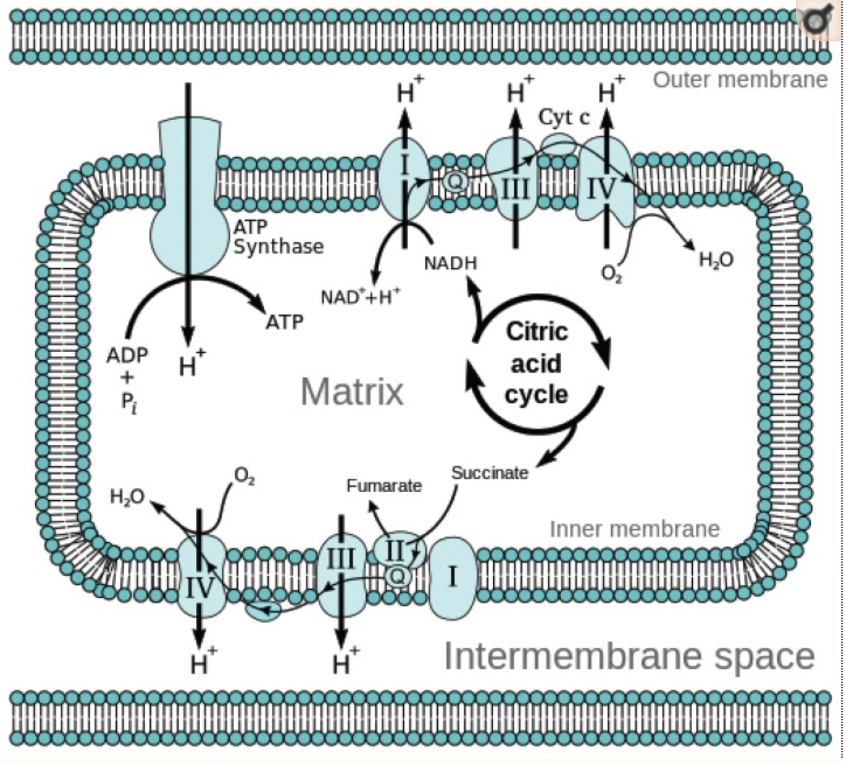
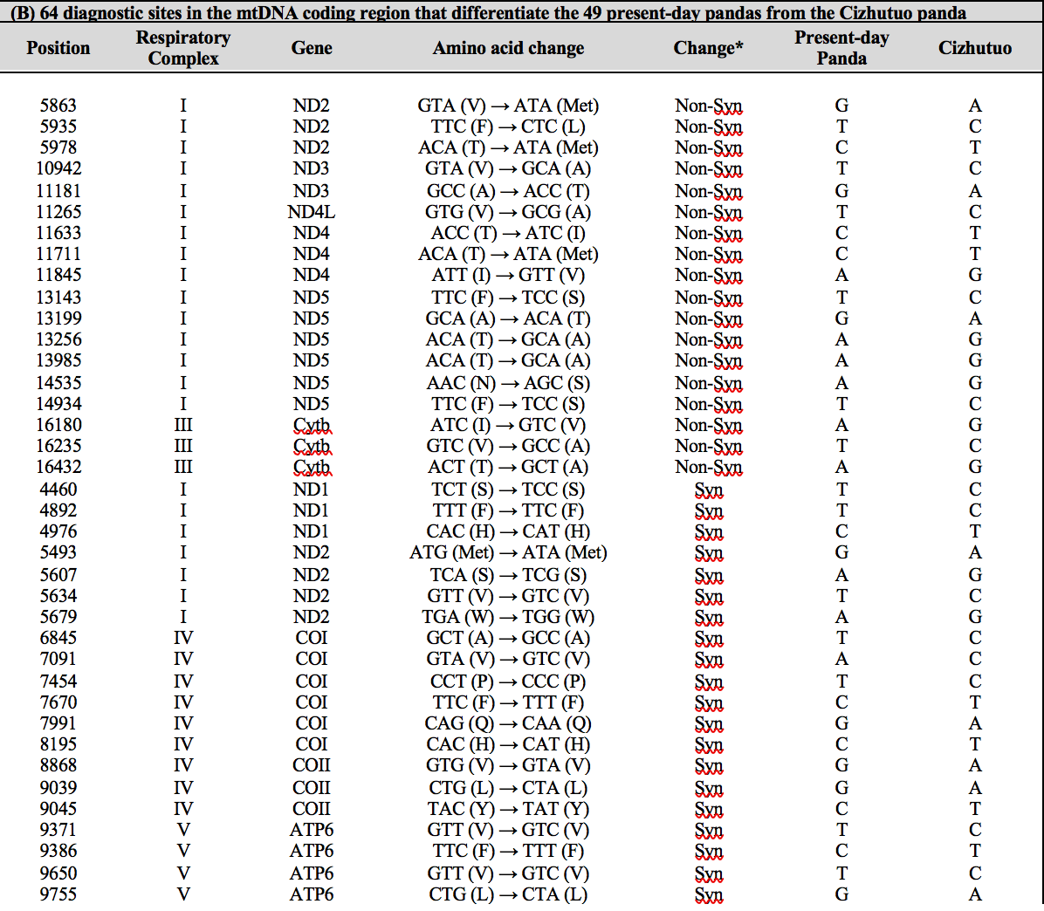
Part 1. mtDNA function with some reference to positive selection

Slide 4
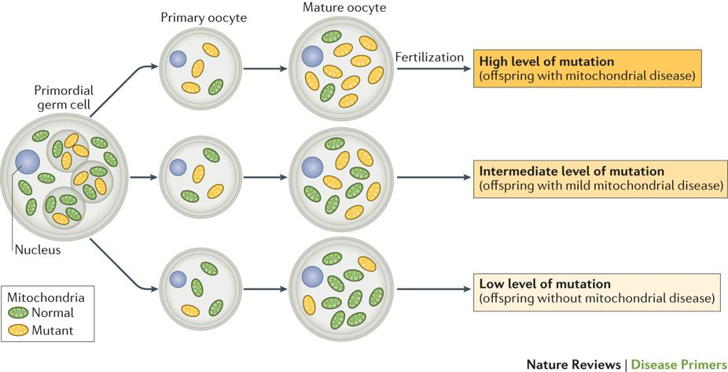
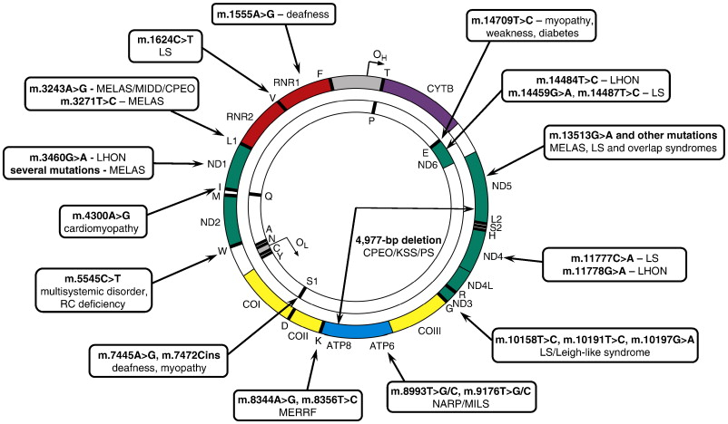
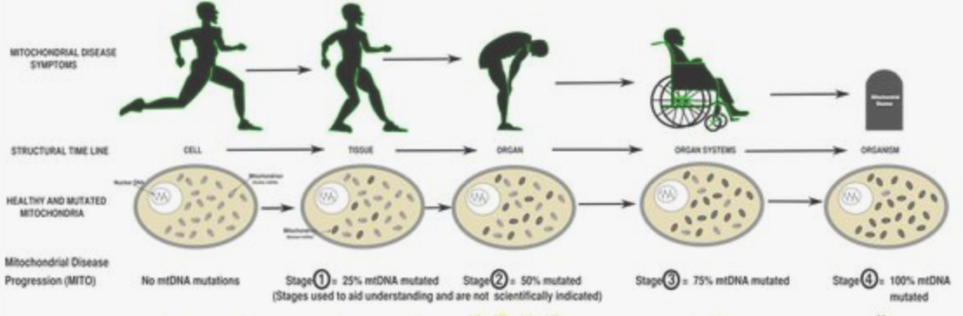
Part 2. mtDNA existing as heteroplasmy
Not all mitochondrial DNA are the identical within a cell, with aging, mitochondrial DNA mutates and exists as a heteroplasmy inside a cell
Homoplasmy
A situation in which all the
mitochondrial DNA molecules
within a cell or organism
are identical.
Heteroplasmy
A mixture of wild-type and
mutant mitochondrial DNA
within the cell. The percentage
of mtDNA containing
mutations can vary from
1% to 99%.
Stewart et al. Nature 2015
Gorman et al. Nature Reviews Disease Primers 2016

Slide 5
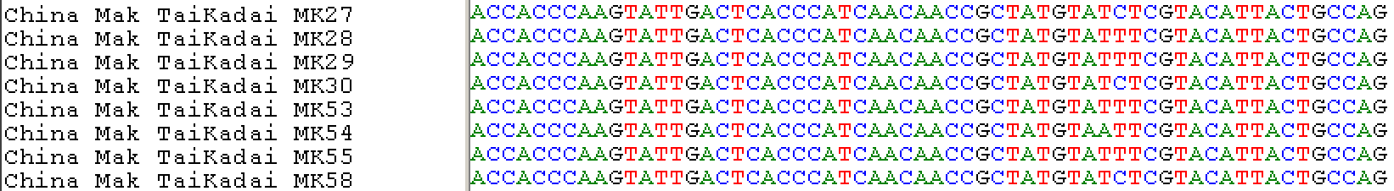
Part 3. Concept of haplogroup that is used in population genetics
Haplotype – point mutation that differentiate the sequence
Point mutation T -> C
3 sequences (MK27, MK30, MK58) sharing one mutation = 3 haplotypes

Slide 6
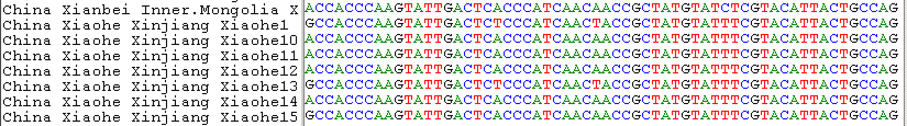
Haplogroup – sharing of more than two mutations
Point mutations at 3 positions
2 sequences (Xiaohe1 and Xiaohe13) sharing same mutations = 2 sequences under “same haplogroup” sharing maternal ancestry

Slide 7
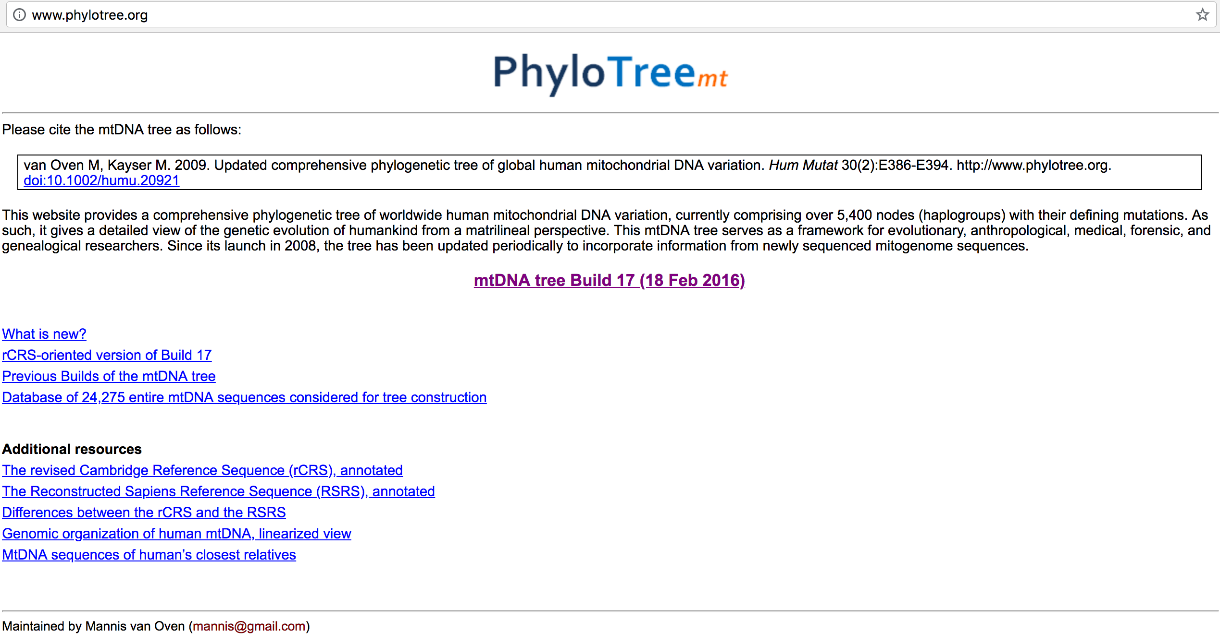
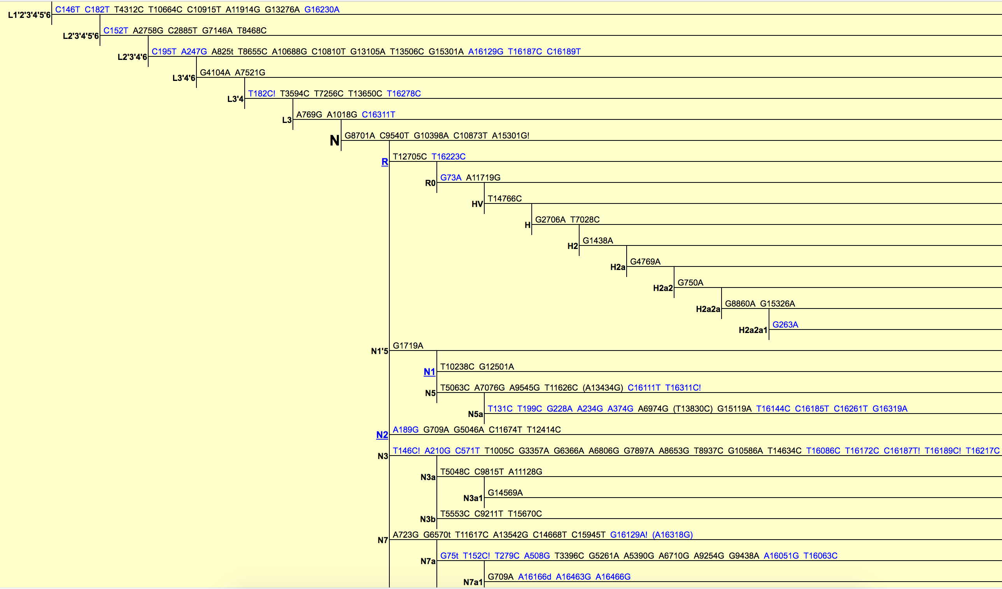
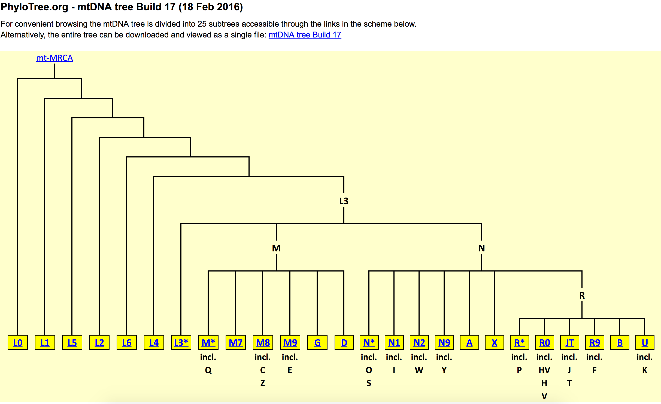
Some notes on annotation:
L1’2’3’4’5’6 = it could be L1 or L2 or L3 or L4 or L5 or L6
C16189T = at position 16189 C (ancestral) ->T (derived)
A15301G! = back mutation at position 15301 from A (derived) -> G (ancestral)
(T13830C) = unstable mutation, sometimes there sometimes not
A16166d = deletion of A at position 16166

Slide 8
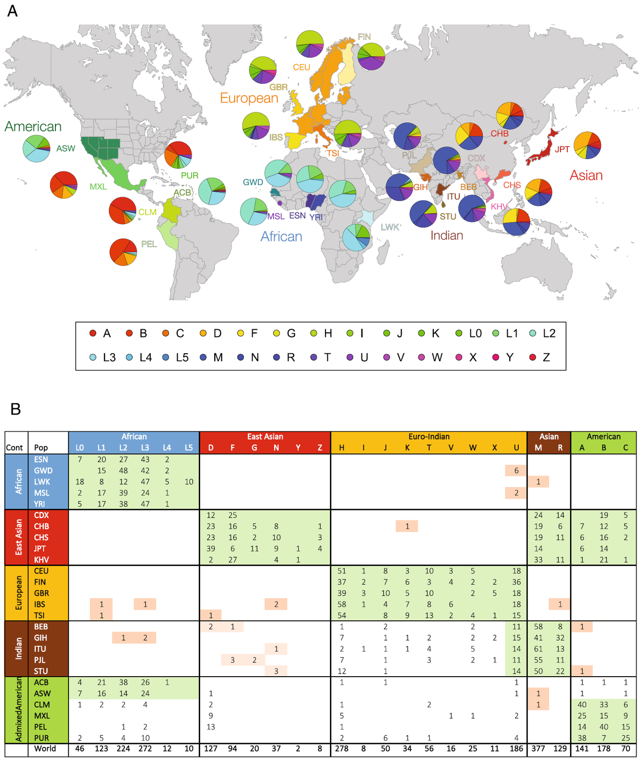
1000 genome project

Slide 9
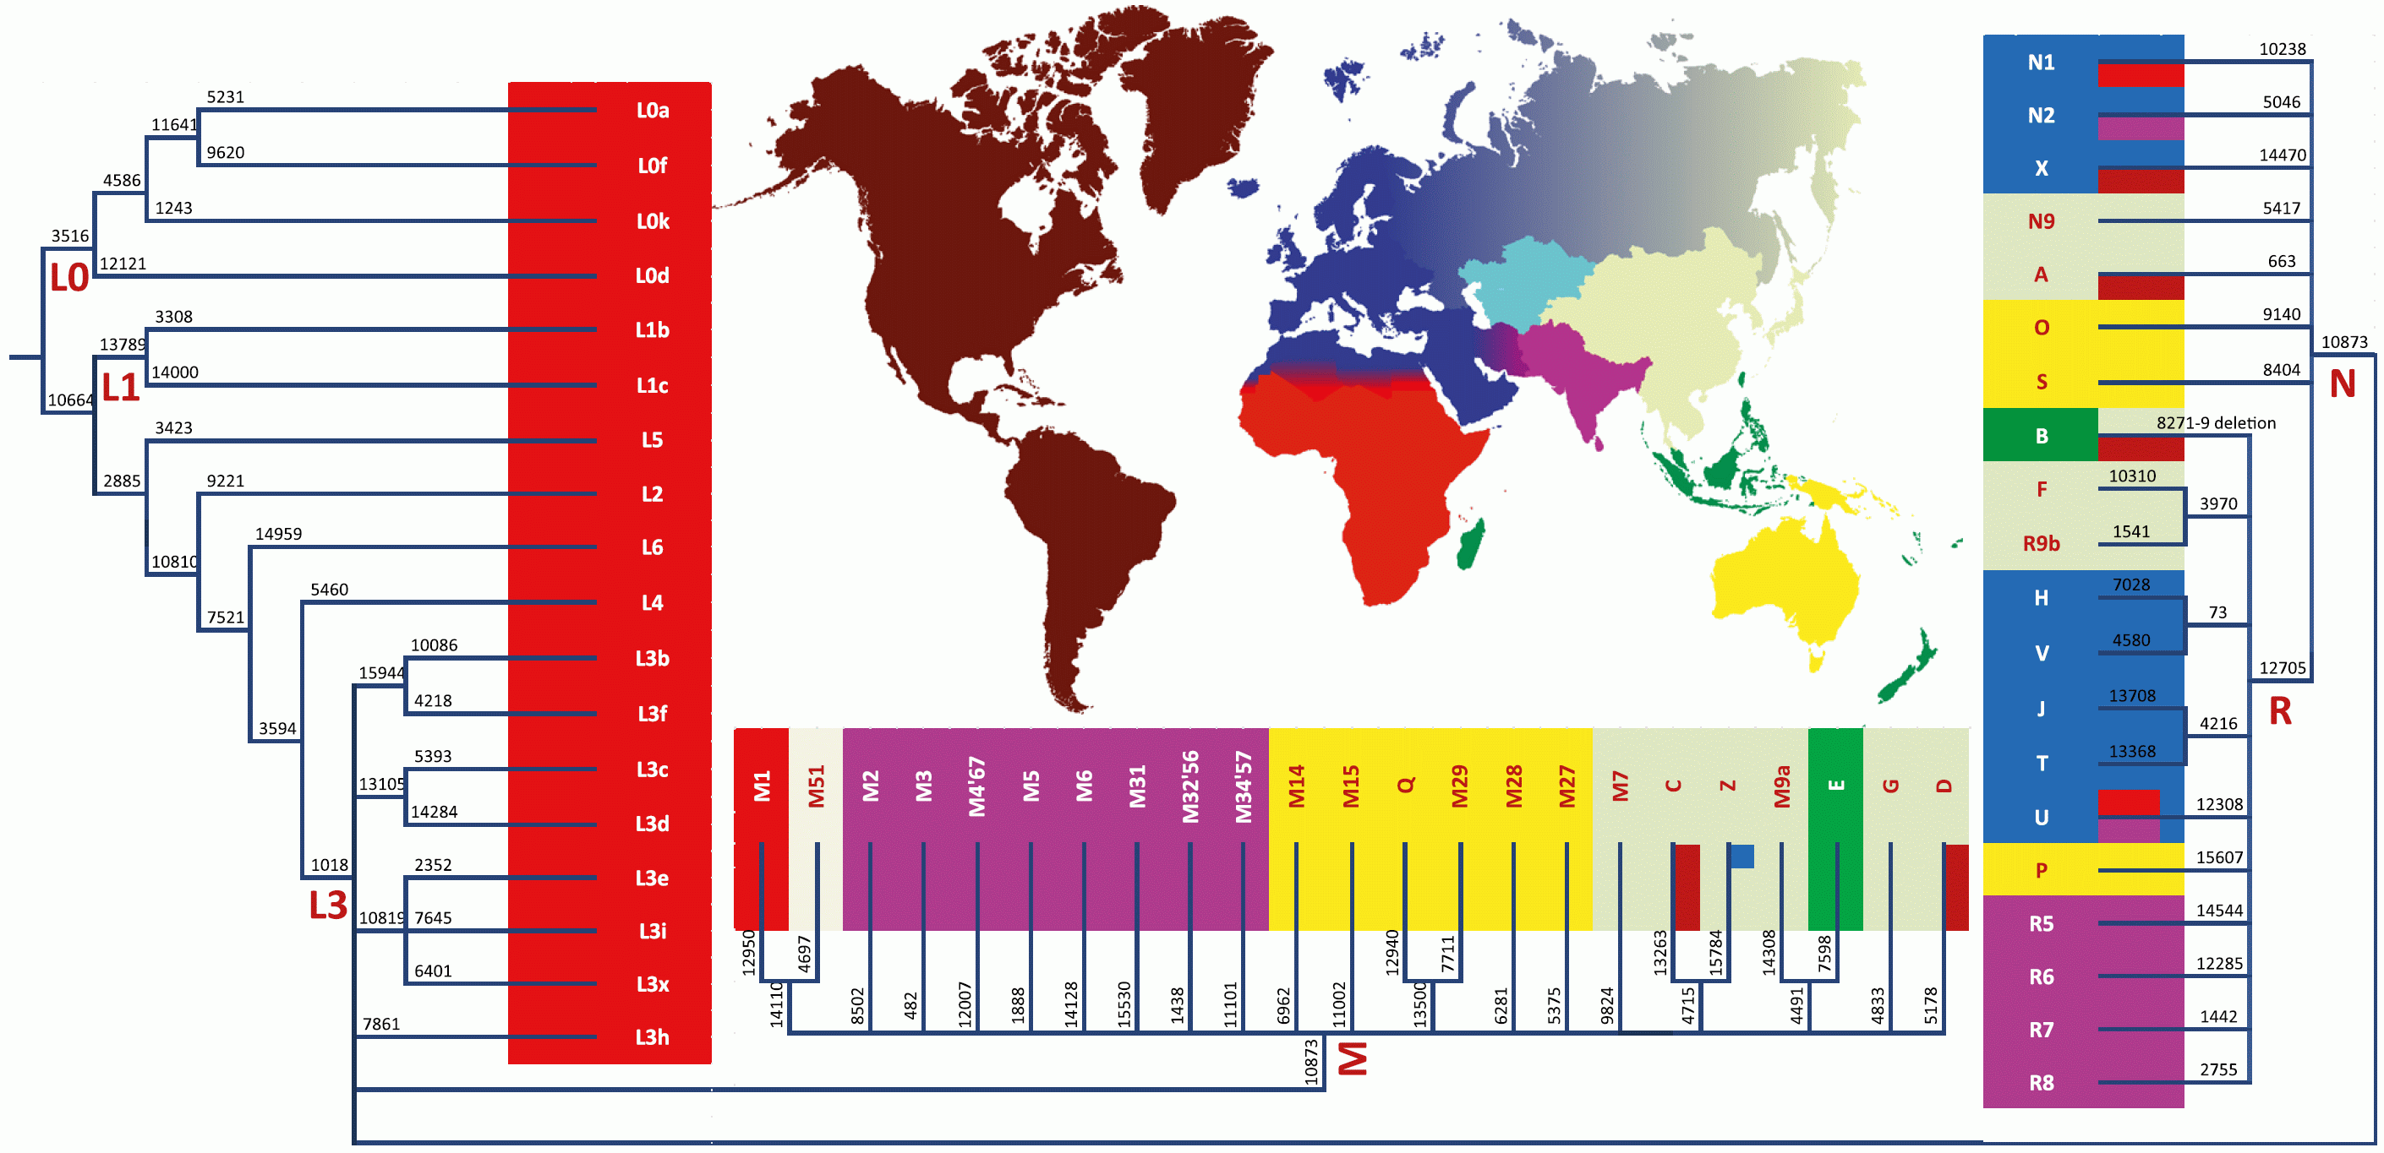

Slide 10
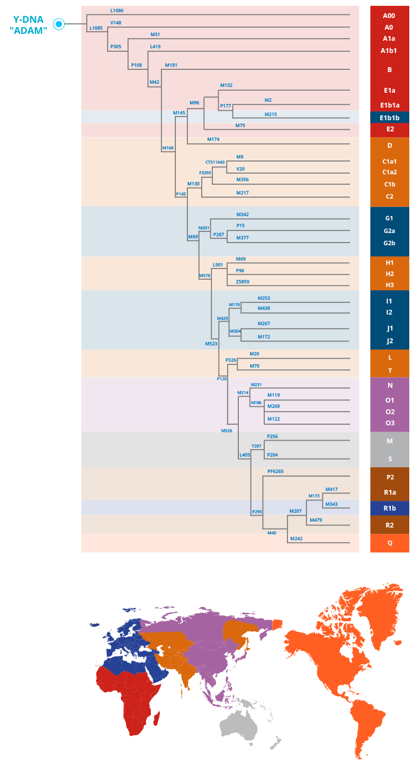
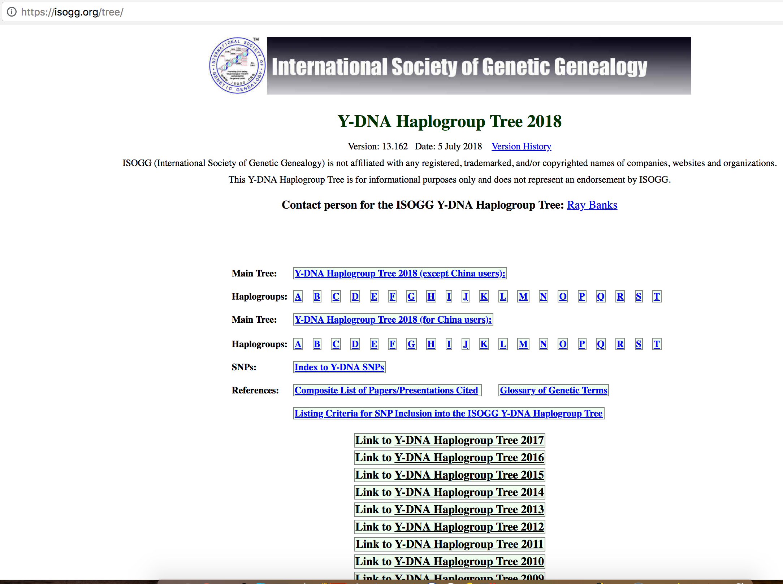

Slide 11
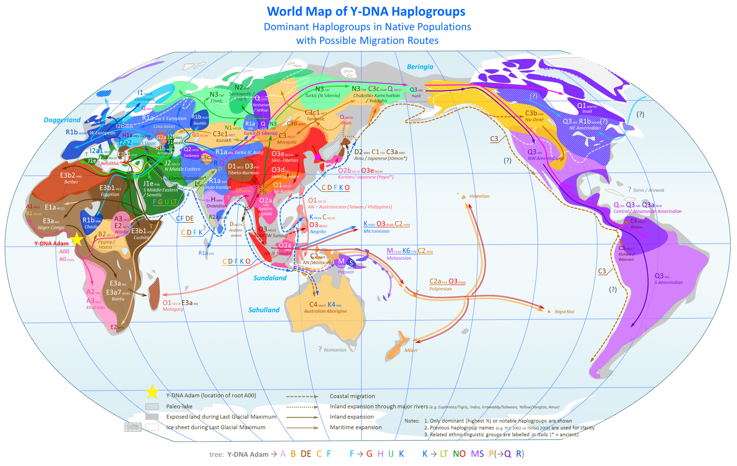
Source: wikipedia

Slide 12
It is important to remember that with uniparental markers (unlike genome-wide data) it is easy to lose ancestry information even within one generation. For example, marrying an African inside China will result introduction of a mitochondrial lineage in China where it previously does not exist, and overtime (if lineage survives) may be ethnically grouped as “Chinese”.
It is not a problem on genome-wide data since there is inheritance from two parents.
This makes a lot of the patterns we see with the spread of haplogroups to be closely linked to geography and occurs in a consecutive order.

